Slide 1
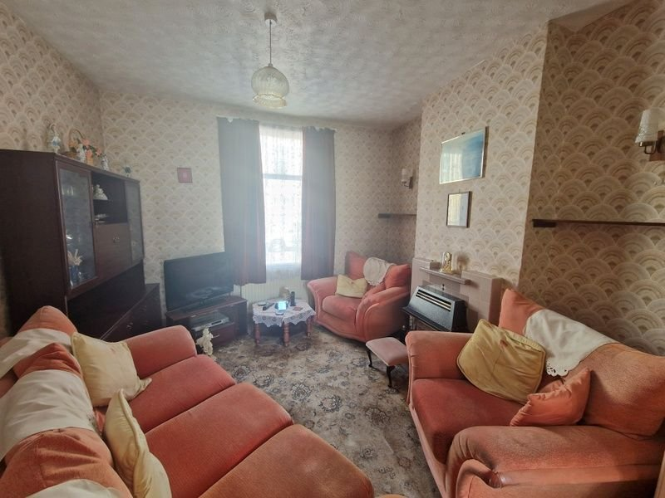
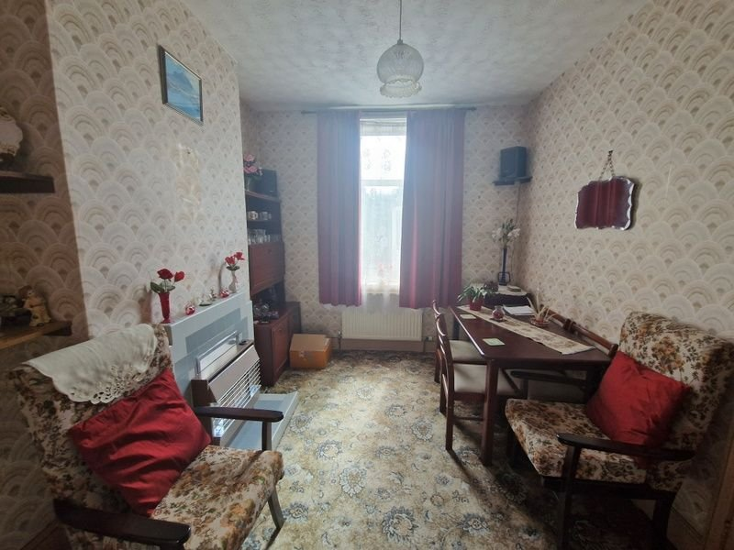
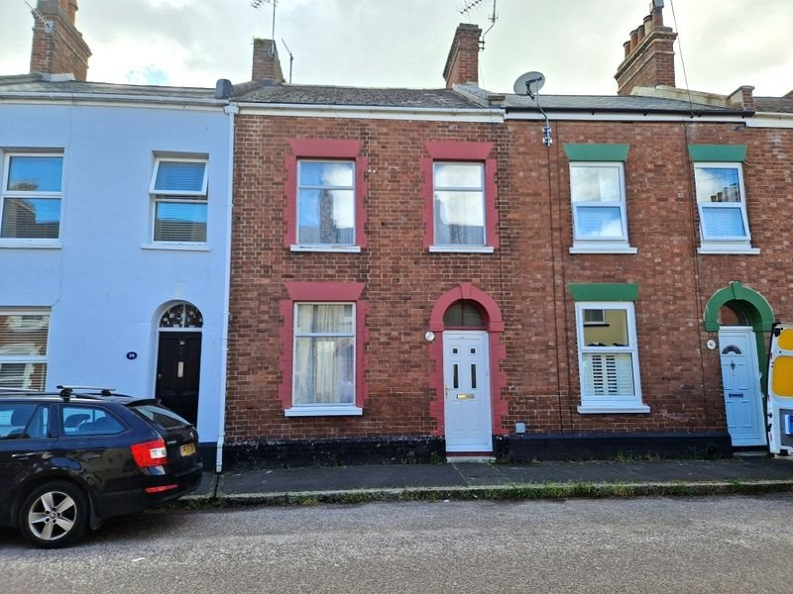
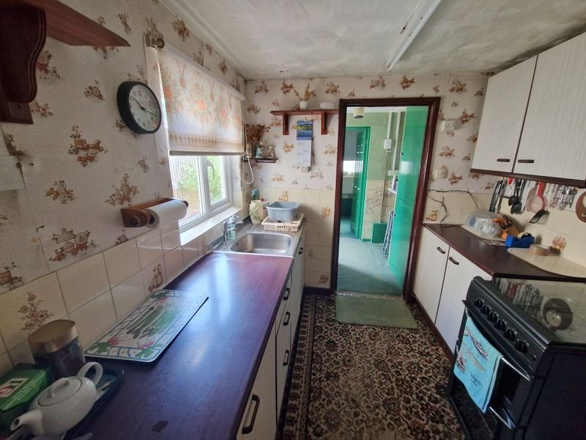
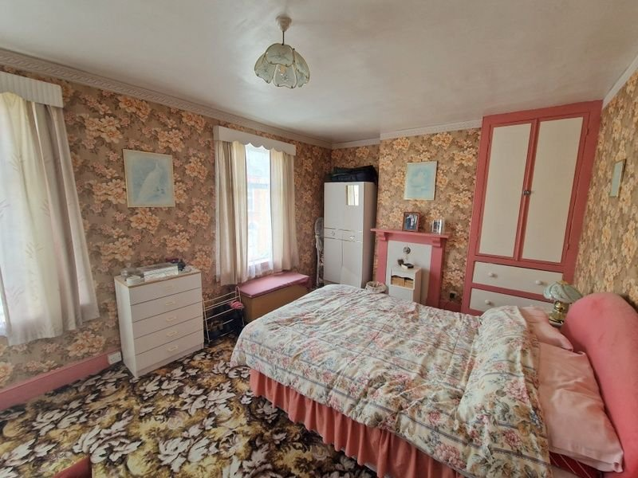
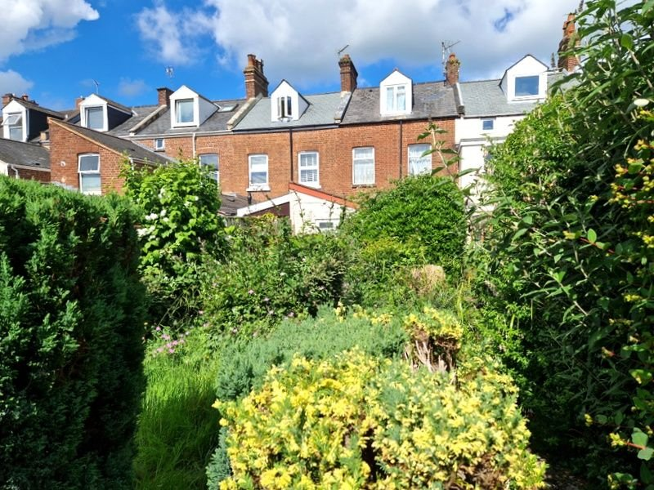
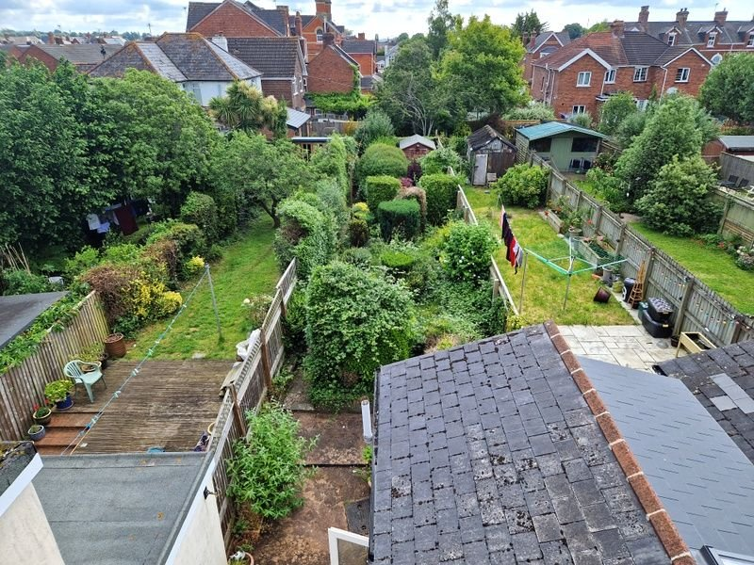
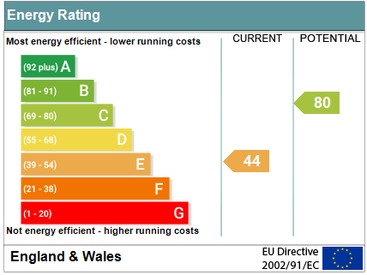
www.pennys.net
37 Regent Street, Exeter, EX2 9EH
GUIDE PRICE £289,950
TENURE Freehold
A Period Terrace Property Located In The Popular St Thomas Area Of Exeter Enjoying Accommodation Arranged Over Three Floors With Generously Sized Rear Garden
General Programme Of Refurbishment And Modernisation Required * Entrance Vestibule * Reception Hall * Lounge And Dining Room * Kitchen * Utility Room * Ground Floor Bathroom/Wc * Three Bedrooms Arranged Over The First And Second Floors * No Onward Chain * Viewing Recommended
Pennys Estate Agents Limited for themselves and for the vendor of this property whose agents they are give notice that:- (1) These particulars do not constitute any part of an offer or a contract. (2) All statements contained in these particulars are made without responsibility on the part of Pennys Estate Agents Limited. (3) None of the statements contained in these particulars are to be relied upon as a statement or representation of fact. (4) Any intending purchaser must satisfy himself/herself by inspection or otherwise as to the correctness of each of the statements contained in these particulars. (5) The vendor does not make or give and neither do Pennys Estate Agents Limited nor any person in their employment has any authority to make or give any representation or warranty whatever in relation to this property.
PENNYS ESTATE AGENTS
2 Rolle House, Rolle Street, Exmouth, Devon, EX8 2SN
Tel: 01395 264111 EMail: help@pennys.net

Slide 2
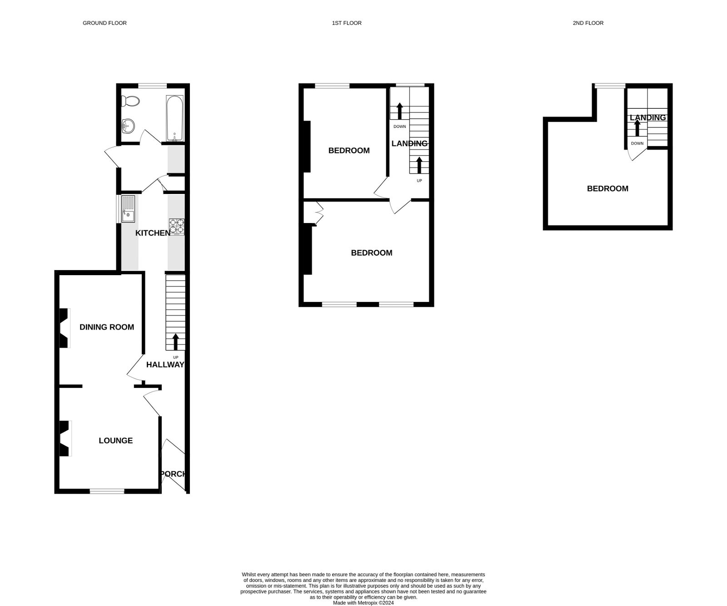
37 Regent Street, Exeter, EX2 9EH
THE ACCOMMODATION COMPRISES: uPVC front door giving access to:
ENTRANCE VESTIBULE: Wall mounted electric meters, inner door to:
ENTRANCE HALL: Radiator, stairs rising to:
FIRST FLOOR LANDING: With understairs cupboard beneath housing gas meter.
LOUNGE/DINING ROOM:
LOUNGE: 3.56m x 3.35m (11'8" x 11'0") Window to front aspect, fitted gas fire housed in tiled surround with matching hearth, TV point, radiator.
DINING ROOM: 3.4m x 2.92m (11'2" x 9'7") With window overlooking the rear aspect. Fitted gas fire housed in tiled fireplace with matching hearth, radiator.
KITCHEN: 2.62m x 2.34m (8'7" x 7'8") With double glazed window and fitted with single drainer sink unit with worktops, cupboards and drawer units, and appliance space beneath. Gas and electric cooker point, wall mounted cupboards, door to:
UTILITY ROOM: 2.44m x 1.7m (8'0" x 5'7") Plumbing for automatic washing machine, wall mounted gas boiler, fitted storage cupboards, double glazed door to rear garden, door to:
GROUND FLOOR BATHROOM/WC: 2.11m x 1.98m (6’11” x 6’6”)
Comprising; bath with shower over, shower curtain rail, pedestal wash hand basin, WC, radiator, double glazed window, mirror fronted medicine cabinet, fully tiled walls.
FIRST FLOOR LANDING: Stairs rising to second floor. Double glazed window and gas convector heater.
BEDROOM 1: 4.78m x 3.35m (15'8" x 11'0") Good size main bedroom with two windows to front aspect, fire surround, built-in wardrobes.
BEDROOM 2: 3.35m x 3.02m (11'0" x 9'11") Window to rear aspect, fire surround.
SECOND FLOOR:
BEDROOM 3: 4.5m x 3.25m (14'9" x 10'8") Good size room with double glazed dormer window overlooking the rear aspect, access points to eaves space, fire surround.
OUTSIDE: To the rear of the property there is a lovely generously sized garden comprising of a variety of mature flowers, shrubs and trees with patio area and pathways, timber garden shed and outside tap.
FLOOR PLAN:

